Slide 1
Conceptual ER Diagram Pet a Dog

Slide 2
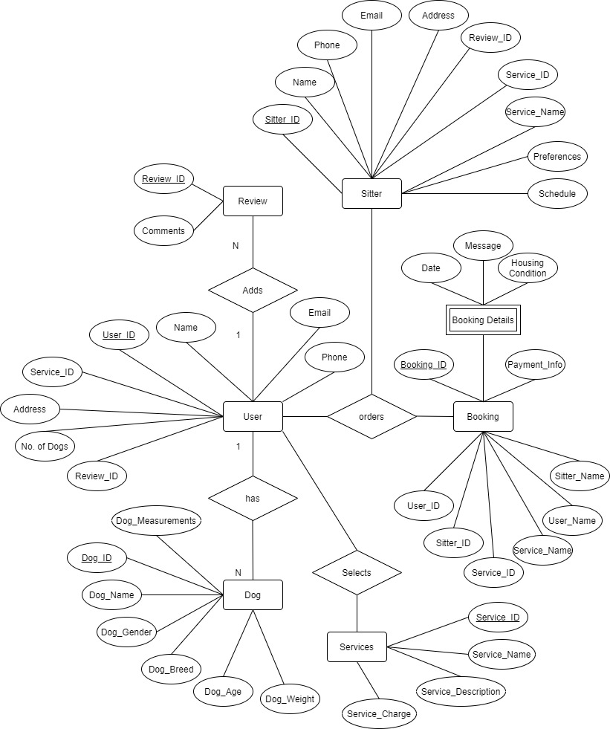

Slide 3
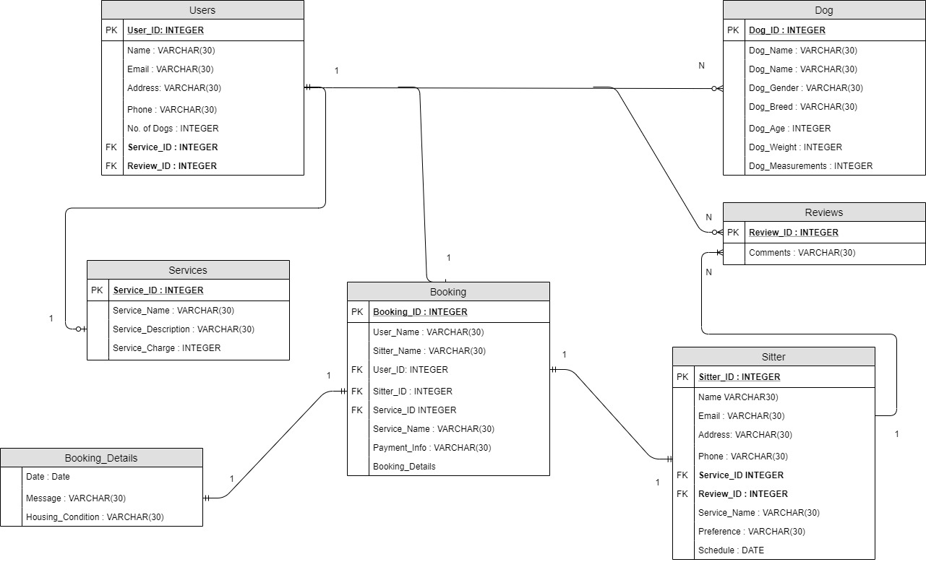
Logical ER Diagram Pet a Dog
PK

